Slide 1
Design Principles (SOLID)
Sept 1, 2016

Slide 2
Introduction to Software Design Principle
SOLID
S – Single-responsibility principle
O – Open-closed principle
L – Liskov substitution principle
I – Interface segregation principle
D – Dependency Inversion Principle
Self Study
Code to Interface Principle
Composite Reuse Principle

Slide 3
Objectives
Learn what are design principles
Explore the SOLID design principles in details.
Learn what could have been the implications if we don’t follow these principles.
How SOLID helps in a good design which is extendable and scalable.

Slide 4
Software Design Principle
Set of guidelines that helps us to avoid having a bad design.
3 important characteristics of a bad design that should be avoided:
Rigidity - It is hard to change because every change affects too many other parts of the system.
Fragility - When you make a change, unexpected parts of the system break.
Immobility - It is hard to reuse in another application because it cannot be disentangled from the current application.

Slide 5
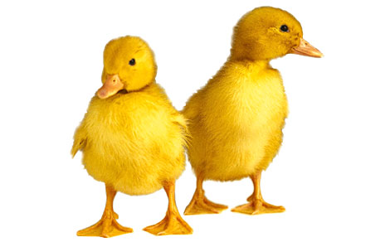
Good Design
Two Aspects
Design should make the application work.
Design is reusable, flexible and maintainable.

Slide 6
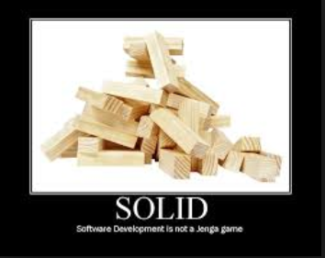
S.O.L.I.D
Guidelines that can be applied while working on software to refactor the software's source code until it is both legible and extensible.
S.O.L.I.D stands for:
S : Single-responsibility Principle
O: Open-Closed principle
L: Liskov Substitute Principle
I: Interface Segregation Principle
D: Dependency Inversion Principle

Slide 7
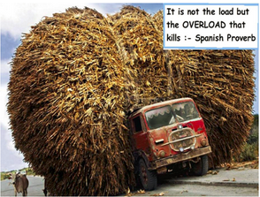
Single Responsibility Principle (SRP)
A class should have a single reason to change, meaning that class should have only one job.
If we have 2 reasons to change for a class, we have to split the functionality in two classes.
Each class will handle only one responsibility and on future if we need to make one change we are going to make it in the class which handle it.

Slide 8

Problem Statement:
An internet and GUI application is planning to use a modem class which should be able to perform the following –
Connect to the server.
Disconnect from the server.
Send the data to server.
Receive data from the server.
Draws the shape of the modem.
The first four behaviour is required by the internet application while the last is required by the GUI application.

Slide 9
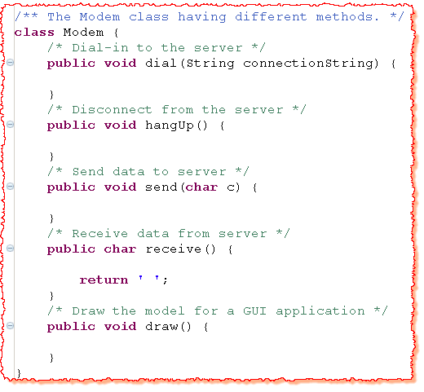

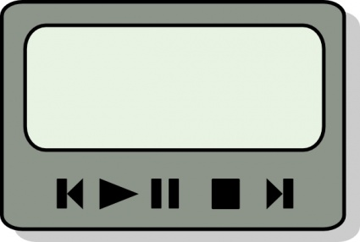
Solution#1
Internet App
GUI App
Notes:
There are two responsibilities being shown here. The first responsibility is connection management. The second is data communication. The dial and hangup functions
manage the connection of the modem, while the send and recv functions communicate data. Should these two responsibilities be separated? Almost certainly they should. The two sets of functions have almost nothing in common. They’ll certainly change for different reasons. Moreover, they will be called from completely different parts of the applications that use them. Those different parts will change for different reasons as well.

Slide 10
Solution#1 | Problems
Responsibility means “Reason for a change” (in context of SRP).
Modem class has the following responsibilities:
Connection Related
Data Transmission Related
Drawing related
InternetGUI application will have the access to methods which it does not require. (deployment overhead)
If only draw method is changed, redeployment required in both the applications.

Slide 11
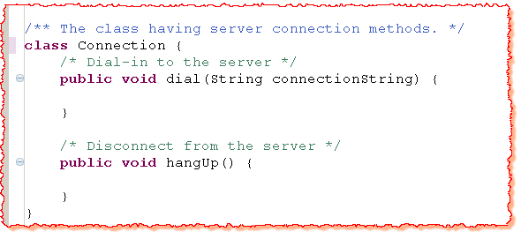

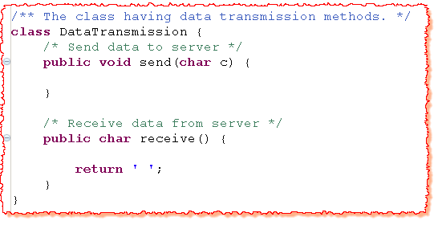
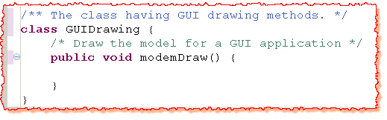

Slide 12
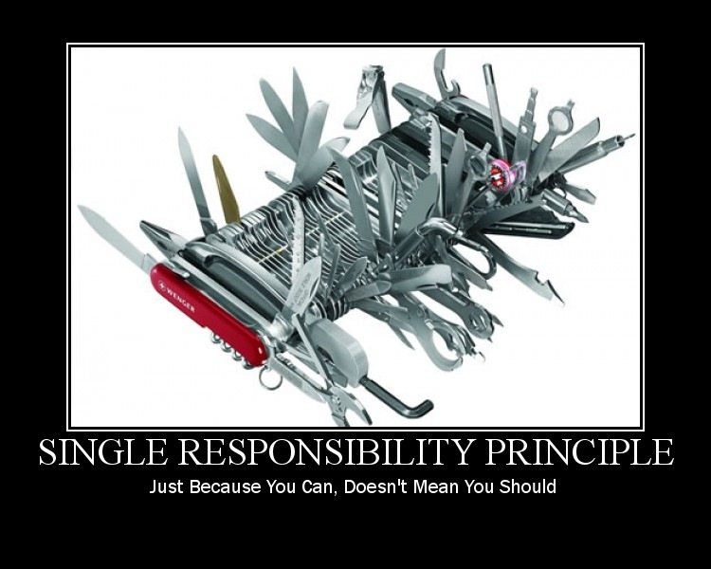
Advantages
Code complexity reduced.
Improved Readability.
Reduced Coupling.
Code has better chances of cleanly evolving.

Slide 13
The Open-Closed Principle (OCP)
A software module (classes, functions and modules) should be open for extension and closed for modification.
Consider it when writing your classes to make sure that when you need to extend their behavior you don’t have to change the class but to extend it.
This principle is applicable when you change the software but it should support backward compatibility, regression testing etc.
Open Close Principle can be ensured by use of Abstract Classes and concrete classes for implementing their behavior.
Some particular cases of OCP are Template Pattern and Strategy Pattern.
Notes:
http://javaboutique.internet.com/tutorials/JavaOO/index2.html
It is all about allowing change without modifying existing code.
It is really combination of encapsulation and abstraction.

Slide 14
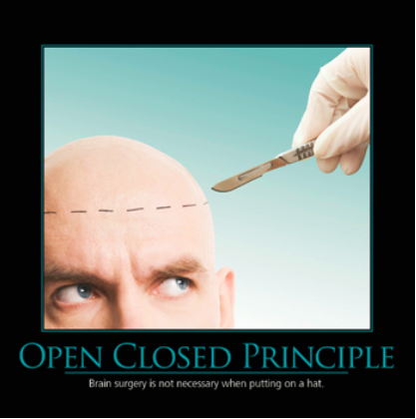
Problem Statement
Design a banking application in which a particular loan is passed through a software module for approval. This software module approves the loan only if the balance in the applicant’s bank account is above certain value.

Slide 15
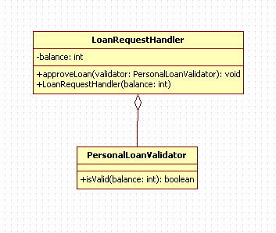
UML Diagram

Slide 16
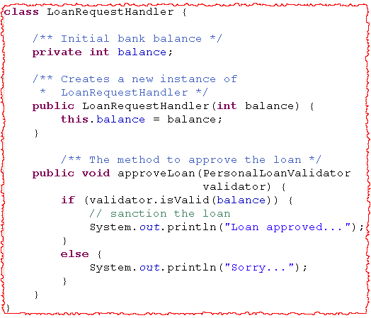

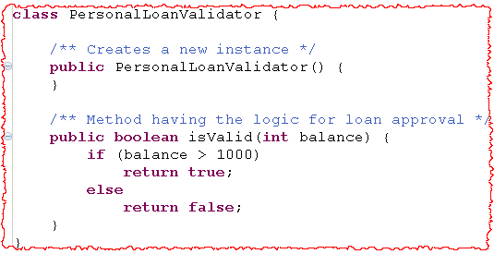

Slide 17
Problem in Solution#1
High Coupling between LoanRequestHandler and PersonalLoanValidator.
Every time bank decides to provide a different type of loan, modifications are required in both the classes.
How to solve above design problems?
Avoid the strong coupling between the two classes.
Abstract the common loan validator and use this abstracted entity in the LoanRequestHandler.
Notes:
Modifying the existing working code will result in re-testing the already tested software module.
Hence, the software module should be closed for modification but open for extension in future. This solution violates the OCP principle.

Slide 18
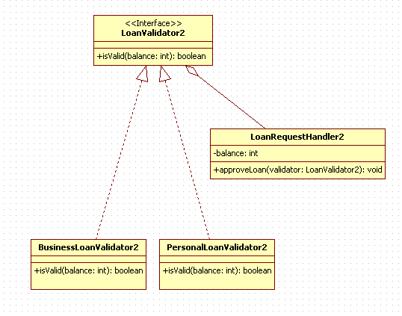
UML Diagram (Solution)

Slide 19

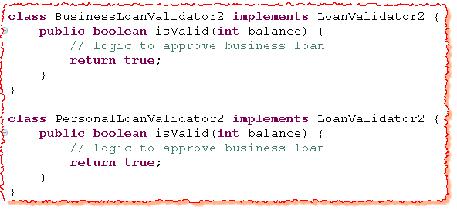
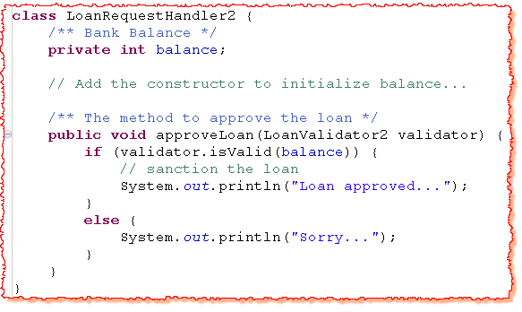

Slide 20
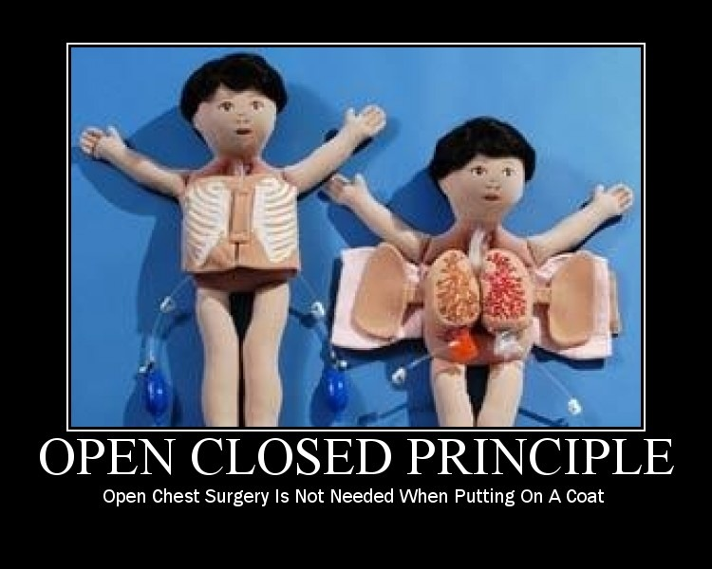
Benefits and Usage
Low Coupling between LoanRequestHandler and PersonalLoadValidator.
No modification required in LoanRequestHandler to handle different types of loan in future.

Slide 21
Liskov’s Substitution Principle (LSP)
Subtypes must be completely substitutable for their base types.
Make sure that new derived classes are extending the base classes without changing their behavior.
New derived classes should be able to replace the base classes without any change in the code.
Problem Statement:
A bank manages two types of accounts – Current Account and Timed Current Accounts. The current account can be closed only if the balance on that account is positive. To close timed current account, the balance needs to be positive and it needs to be open for at least 6 months. The Timed Current Accounts give additional 1% interest. Design the classes.
Some Facts:
All methods except closing an Account and calculating interest rate are same.
Notes:
http://ima.udg.edu/~sellares/EINF-ES1/OCP-Lisk-DIP.pdf
A good explanation of this principle can be found it the following video
https://www.youtube.com/watch?v=Orhu0x5aplI

Slide 22
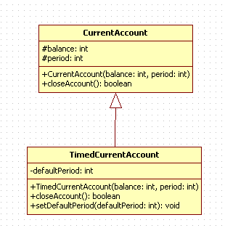
UML Diagram

Slide 23
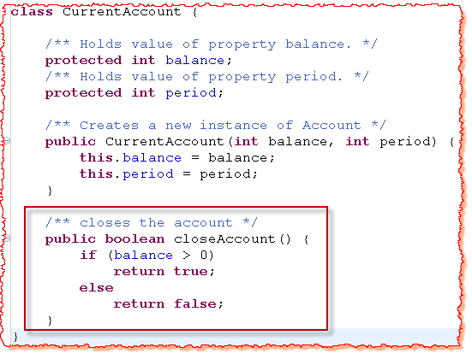

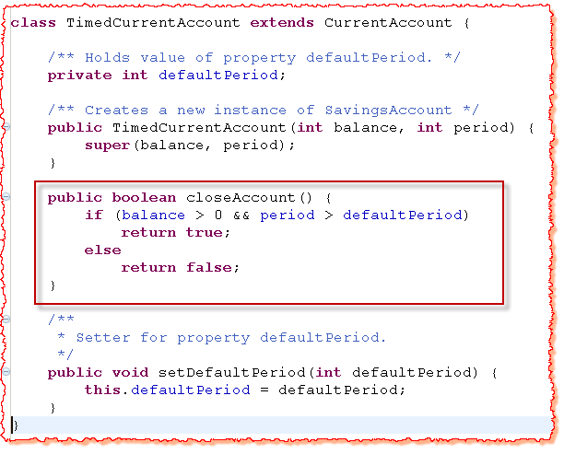
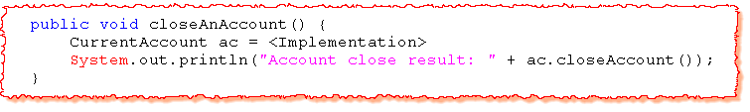
Behaviour dependant upon the object type.
Notes:
http://coronet.iicm.tugraz.at/sa/s5/sa_oo6.html
http://bmwieczorek.wordpress.com/2010/10/02/lsp-liskov-substitution-principle/

Slide 24

Problem in Solution#1
Unexpected Result.
User to know the internal implementation of the classes.
How to solve above design problems?
Subclasses should completely replace the base class.
Design by Contract Principle
Notes:
http://ima.udg.edu/~sellares/EINF-ES1/OCP-Lisk-DIP.pdf
Unexpected Result – If a developer remembers the behaviour of only the base class, he will get unexpected result.
TimedCurrentAccount can’t completely replace CurrentAccount as the closeAnAccount behaviours are different.

Slide 25
Design by Contract
Each method can have pre-conditions and post-conditions.
Pre-conditions
Criteria to be met before the method offers a behaviour
Post-condition
State or behaviour offered by the method after it meets preconditions
A sub-type can only have
weaker pre-conditions
and
stronger post-conditions
than its base class.
Notes:
http://ima.udg.edu/~sellares/EINF-ES1/OCP-Lisk-DIP.pdf

Slide 26
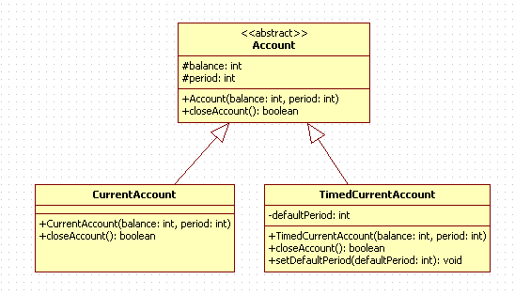
UML Diagram(Solution)

Slide 27
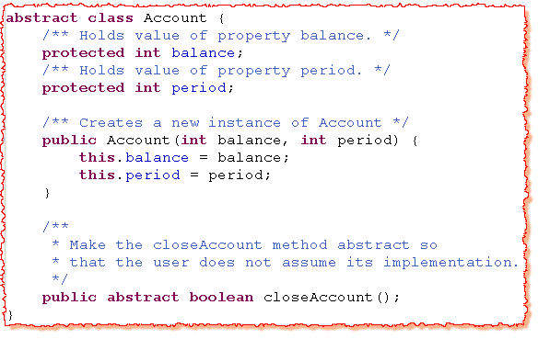
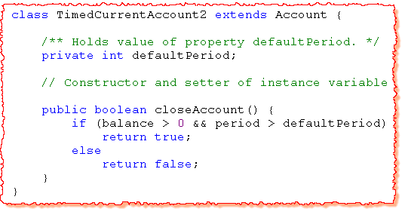
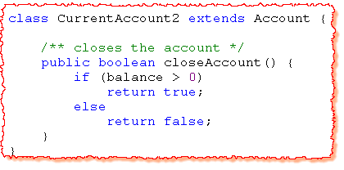

Slide 28
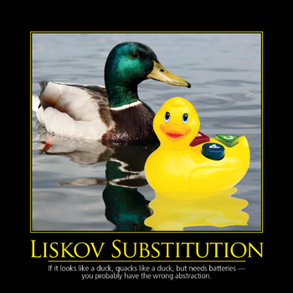
Benefits and Usage
The user won’t assume the implementation of closeAccount method.
Always Remember
“Derived classes must enforce
weaker pre-conditions and stronger
post-conditions while overriding any
base class method”

Slide 29
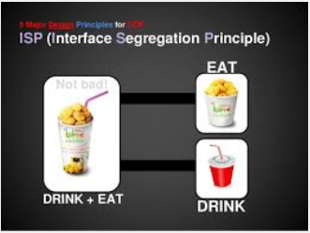
Interface Segregation Principle (ISP)
Many specific interfaces are better than a single general interface.
A client should never be forced to implement an interface that it doesn’t use or clients shouldn’t be forced to depend on methods they do not use.
Add only methods to an interface that should be there. If we add methods that should not be there the classes implementing the interface will have to implement those methods as well.
Interfaces containing methods that are not specific to it are called polluted or fat interfaces. We should avoid them.
Notes:
http://javaboutique.internet.com/tutorials/JavaOO/interface_segregation.html
http://www.objectmentor.com/resources/articles/isp.pdf

Slide 30
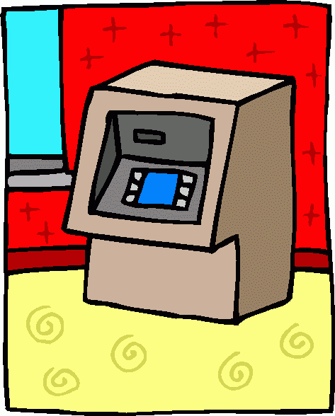
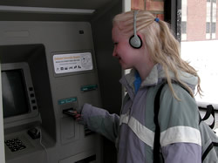
Problem Statement:
An ATM can have the following types of output – a screen and a speech. It supports the following two types of transactions – deposit and withdrawal. A company supports two types of ATMs – only screen (for people who can see) and screen with speech (for handicapped people ). Design the classes.

Slide 31
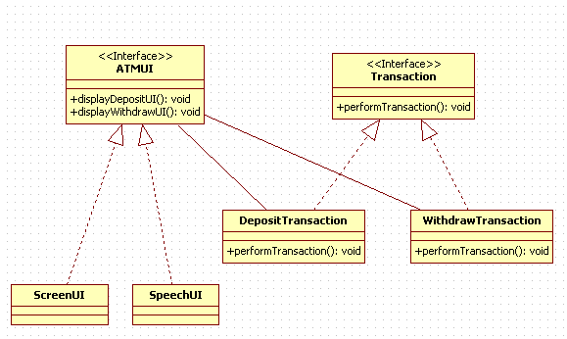
UML Diagram

Slide 32
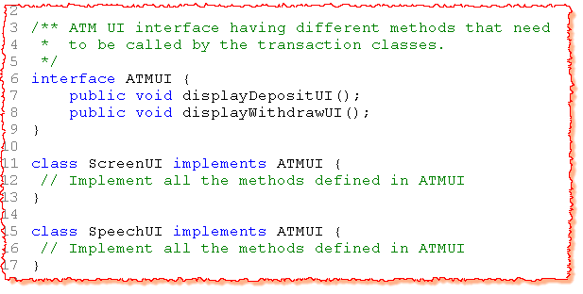
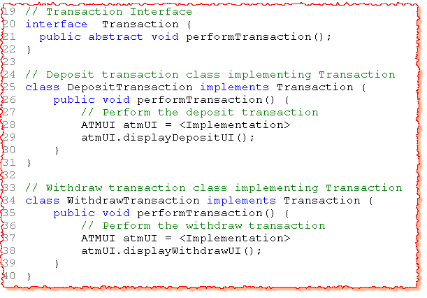
Solution#1

Slide 33
Solution#1 | Problems
Contract change in one UI will affect the other UI implementations.
Fat interface – Grow rapidly.
Notes:
What if the company plans to introduce cancel button only on ScreenUI. The ATM interface will have this contract but SpeechUI need to give the default implementation of it which is not desirable.
What if the company likes to introduce a new contract displayStatusUI for withdraw transactions. This contract is required only for withdraw transactions. If the balance is not sufficient then an account status message is displayed. This will lead addition of a new method displayStatusUI in the ATMUI and the deposit transaction will also have the access to it though it does not require.
When a single interface is designed to support different groups of behaviors, they are poorly designed and are called Fat interfaces. They are called Fat because they grow enormously with each additional function required by clients using that interface.
Change in the contract of only one implementation of UI (e.g. ScreenUI) will affect the other UIs implementing the common interface.
Transaction classes are exposed to some redundant methods that they don’t require.
If two or more objects implementing the interface depict different sets of behaviors, then they probably cannot subscribe to a single interface.

Slide 34
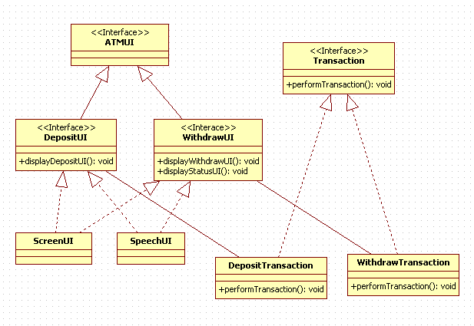
UML Diagram (Solution)

Slide 35
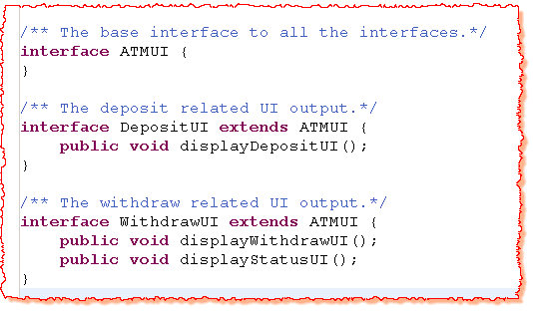
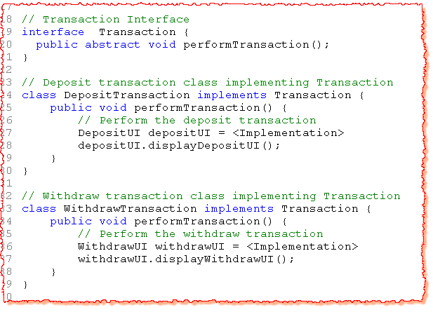
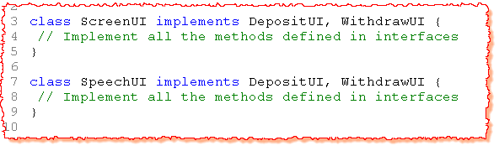

Slide 36
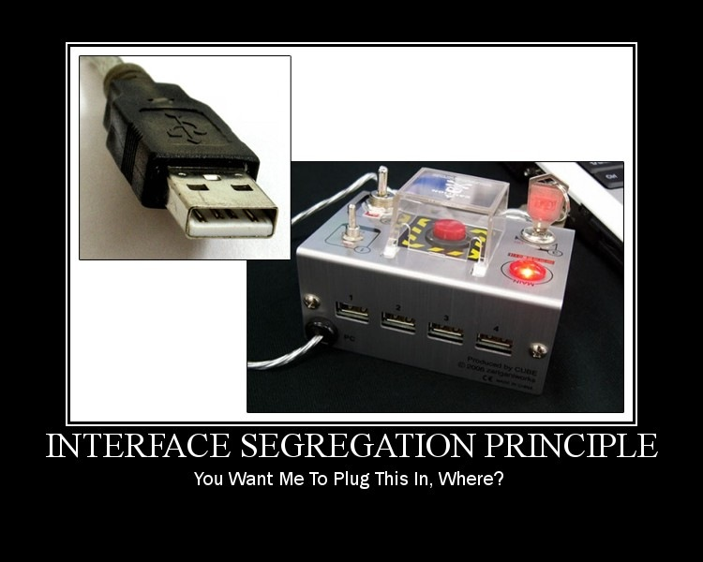
Advantages
Small and relevant contracts.
Easy to understand and maintain.
Contract change in one UI will not affect the other UI implementations.

Slide 37
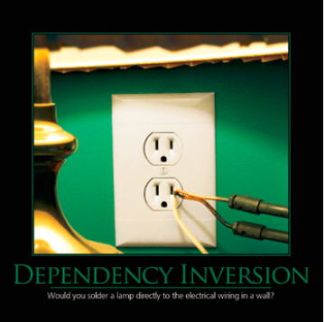
Dependency Inversion Principle
I Don't Care How, Just Give Me What I Want
Entities must depend on abstractions not on concretions. It states that the high level module must not depend on the low level module, but they should depend on abstractions.
Also known as “Inversion of Control”.
Factories and Abstract Factories can be used as dependency frameworks, but there are specialized frameworks for that, known as Inversion of Control Container.

Slide 38
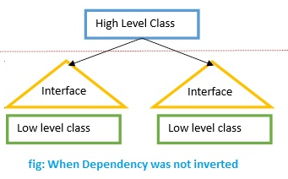
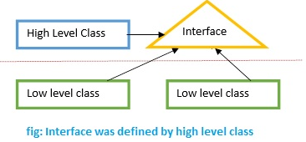
DIP with Example
Case 1: Dependency not inverted (high level module depend on low level module)
Case 2: Dependency Inversion

Slide 39

Problem Statement:
Imagine a sample where we have developed a class which contains a highly sophisticated encryption algorithm. This class takes as an input a source file name and a target file name. The content to encrypt is then read from the source file and the encrypted content is written to the target file.

Slide 40
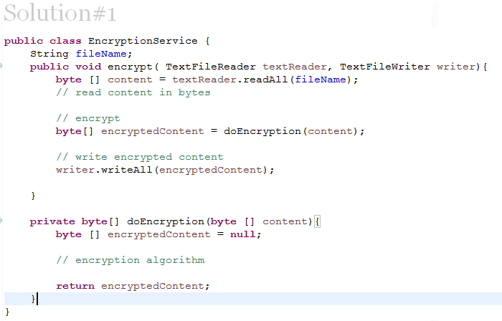
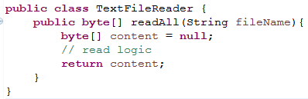
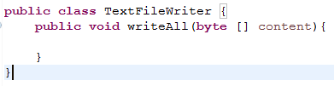

Slide 41
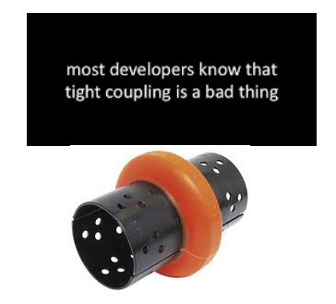
Problems
Highly coupled to a certain input and output.
Encryption algorithm can not be used in another context where the encrypted content should not e written to a file but rather sent to a web service.

Slide 42
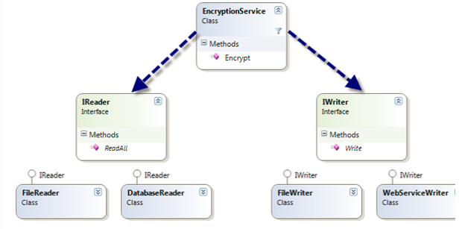
UML Diagram
Consider the simple class diagram below:

Slide 43
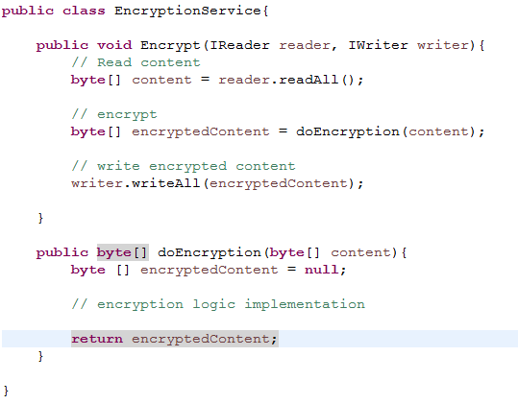


Solution #2

Slide 44
Benefits
Encrypt method of the encryption service is now independent of a specific content reader or writer.
The dependencies have been inverted; the Encryption Service class depends upon abstractions, and the detailed readers and writers depend upon the same abstractions.
Now we can reuse the encryption service. We can invent new kinds of “Reader” and “Writer” implementations that we can supply to the Encrypt method of the service.

Slide 45
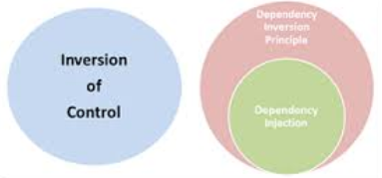
Why call it dependency inversion?
The dependency structure of a well designed object oriented application is “inverted” with respect to the dependency structure that normally results from a “traditional” application which is implemented in a more procedural style.
In a procedural application high level modules depend upon low level modules and abstractions depend upon details.

Slide 46
Composite Reuse Principle (CRP)
Self Study
Favour composition over inheritance as a way of achieving polymorphism.
Problem Statement:
Design a payroll system for an organization. The organization has three types of employees – Regular, Part-time and Temporary. The regular and part-time employees are given bonus as a fixed % of their base salary while the temporary gets a fixed lump sum amount as the bonus. The company gives same amount of insurance cover to all its employees.
Notes:
http://javaboutique.internet.com/tutorials/JavaOO/index3.html

Slide 47
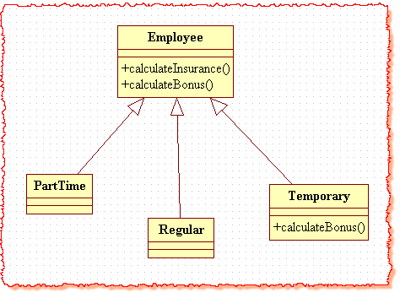
Solution#1
Now the organization adds an new Contractor Employee and likes to give bonus to its contractors as well. It likes to give exactly same bonus to its contractors as it is giving to its temporary employees.

Slide 48
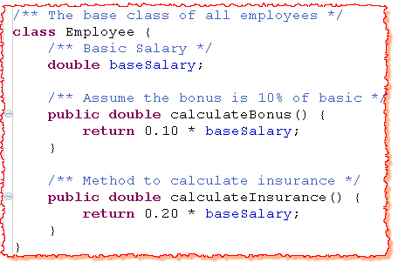
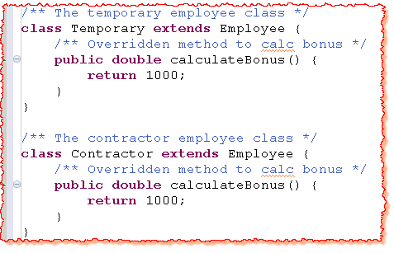

Solution#1 (Contd..)

Slide 49

Solution#1 (Contd..)
Two approaches
Contractor extends Temporary
Contractor extends Employee but calculateBonus code is duplicated.
Both the above approaches has limitations
Contractor is not a temporary employee.
Duplication of code leads to more maintenance efforts.
Hence, the original class structure (implemented through inheritance) was highly limiting to incorporate the change in requirements.

Slide 50

UML Diagram(Solution)

Slide 51




Slide 52

Benefits
No duplication of code.
Easy to modify later.
BonusCalculator logic can be changed dynamically.
Notes:
e.g. A Bird may need only the fly behavior of an Airplane. In this case, it makes sense to extract it out as an interface / class / both and make it a member of both classes.

Slide 53



Program to an interface (PTI)
Self Study
Do not tie the relationship to classes but tie them to interfaces.
Problem Statement:
A gaming application is planning to use car, boat and bike for water sport. The player should be able to move left, right, forward, reverse and set the speed of the vehicle. The application should also demonstrate the manoeuvring of these vehicles with the help of a demo.
Notes:
http://stackoverflow.com/questions/383947/what-does-it-mean-to-program-to-an-interface
http://fatagnus.com/program-to-an-interface-not-an-implementation/
http://fatagnus.com/program-to-an-interface-not-an-implementation/

Slide 54

UML Diagram

Slide 55



Solution#1

Slide 56
Solution#1 | Problems
Code duplication.
The impact if the signature of a method changes.
The impact if the application discontinues one of its vehicle.
Notes:
Access to all public methods of the class (even if these are not meant to be exposed to the client - internal algorithmic implementations of different actions).

Slide 57


Slide 58

Advantages
Differentiated ‘what’ versus ‘How’.
No impact on the client as long as the contract with the client does not change.
All disadvantages of solution#1 are solved.
Standard interface for all cars, implementation may be different !
Notes:
Differentiated “what”(Interface) versus “How”(Implementation).

Slide 59
Recap
Bad design characteristics-
Rigidity
Immobility
Fragility
Good Design
Flexible
Maintainable
Reusable
SOLID
S : Single-responsibility Principle
O: Open-Closed principle
L: Liskov Substitute Principle
I: Interface Segregation Principle
D: Dependency Inversion Principle

Slide 60
Recap
Single Responsibility Principle (SRP)
A class should have a single reason to change, meaning that class should have only one job.
If we have 2 reasons to change for a class, we have to split the functionality in two classes.
Each class will handle only one responsibility and on future if we need to make one change we are going to make it in the class which handle it.
The Open-Closed Principle (OCP)
A software module (classes, functions and modules) should be open for extension and closed for modification.
Consider it when writing your classes to make sure that when you need to extend their behavior you don’t have to change the class but to extend it.
This principle is applicable when you change the software but it should support backward compatibility, regression testing etc.
Open Close Principle can be ensured by use of Abstract Classes and concrete classes for implementing their behavior.
Some particular cases of OCP are Template Pattern and Strategy Pattern.

Slide 61
Recap
Liskov’s Substitution Principle (LSP)
Subtypes must be completely substitutable for their base types.
Make sure that new derived classes are extending the base classes without changing their behavior.
New derived classes should be able to replace the base classes without any change in the code.
Interface Segregation Principle (ISP)
Many specific interfaces are better than a single general interface.
A client should never be forced to implement an interface that it doesn’t use or clients shouldn’t be forced to depend on methods they do not use.
Add only methods to an interface that should be there. If we add methods that should not be there the classes implementing the interface will have to implement those methods as well.

Slide 62
Recap
Dependency Inversion Principle
I Don't Care How, Just Give Me What I Want
Entities must depend on abstractions not on concretions. It states that the high level module must not depend on the low level module, but they should depend on abstractions.
Also known as “Inversion of Control”.
Factories and Abstract Factories can be used as dependency frameworks, but there are specialized frameworks for that, known as Inversion of Control Container.

Slide 63
References
https://en.wikipedia.org/wiki/SOLID_(object-oriented_design)
https://scotch.io/bar-talk/s-o-l-i-d-the-first-five-principles-of-object-oriented-design

Slide 64
THANK YOU

